Slide 1
British Airways Insights
Johnny Yang

Slide 2
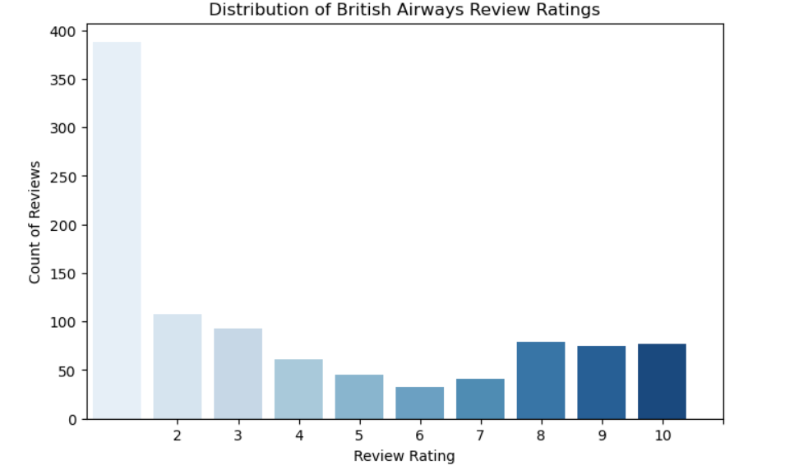
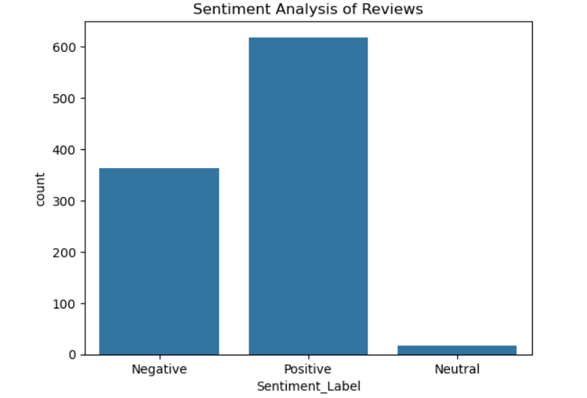
Summary of Findings
Majority of reviews: Under 5 stars
Common Praises: Excellent flight crew
Common Complaints: delays, poor ground service, cancellations
Sentiments:
61.9% Positive
36.4% Negative
1.7% Neutral
Conclusion: While customers appreciate the cabin service, many are dissatisfied with delays, poor ground service, and cancellations.

